Slide 1
SQL Server Reporting Services
Dot Net Developer
Oanh Nguyễn

Slide 2
Agenda
What is SSRS?
History of SQL Server Reporting Services
Reporting Life Cycle
Architecture
Important Aspects of SSRS

Slide 3
What is SSRS?
Microsoft SQL Server services: SSAS, SSIS, SSRS
SQL Server Reporting Services (SSRS) is a server-based report generation software system from Microsoft.
It can be used to prepare and deliver a variety of interactive and printed reports.
It is administered via a web interface.
Reporting services features a web services interface to support the development of custom reporting applications
Notes:
This definition from Wiki (http://en.wikipedia.org/wiki/SQL_Server_Reporting_Services)
SSAS (SQL Server Analysis Services) : A component for online analytical processing (OLAP) and data mining. OLAP performs data aggregation and allows users to traverse from aggregations to details looking through the dimensions (such as geography or time) of data. Data mining helps users to discover patterns in data.
SSIS (SQL Server Integration Services): A component for extracting, transforming, and loading (ETL) data.
SSRS (SQL Server Reporting Service) : SSRS provides a unique interface into Microsoft Visual Studio so that developers as well as SQL administrators can connect to SQL databases and use SSRS tools to format SQL reports in many complex ways. SSRS also provides a 'Report Builder' tool for less technical IT workers to format SQL reports of lesser complexity.
Crystal Report made by SAP Germany (to manage business operations and customer relations. Headquartered)

Slide 4
History of SQL Server Reporting Service
Originally Released in 2004 as a web release for SQL Server 2000
Included as part of the product in SQL Server 2005 with many enhancements
Report Models and Report Builder
Multi Valued Parameters
Printing Support
Notes:
A report model is an additional layer of information that maps database tables and views into concepts that are meaningful to business users. A well-designed report model should reflect the information that business users want to report on organized in a meaningful way.

Slide 5
History of SQL Server Reporting Service
Enhanced again for inclusion in the SQL Server 2008 release
New “Tablix” implementation of report elements
Inclusion of Dundas charting and gauge components
Out of the box support for SharePoint integration
New & Improved Report Builder 2.0

Slide 6
The Reporting Lifecycle
Authoring
Reports syntax is Report Definition Language (.rdl)
Included Report tools
SQL Server Business Intelligence Development Studio
Report Builder 3.0
Management
Report Manager web interface
Role Base security model based on Windows Authentication
Control over “Execution” (When reports get their data)

Slide 7
The Reporting Lifecycle
Delivery
Web based delivery via Report Manager web site
Subscriptions allow for automated report delivery
URL Access, Web Services and Report Viewer control
Notes:
Explain for Reporting Lifecycle

Slide 8
Architecture
SQL Server Requirements
Web Server Requirements
Architecture Overview

Slide 9
SQL Server Requirements
SSRS is included with all editions of SQL Server including Express
Features grow with the Edition
Remote Data Sources
Subscriptions
Memory Limits
SSRS stores its own data in SQL Server DBs
Report Server
Report Server Temp DB
Notes:
Remote Data Sources: ???
Subscriptions: A subscription is a standing request to deliver a report at a specific time or in response to an event, and then to have that report presented in a way that you define. Subscriptions provide an alternative to running a report on demand (http://www.databasejournal.com/features/mssql/data-driven-subscription-in-ssrs-2008-r2.html)
Memory Limits: The report processing uses a file system cache to adapt to memory pressure and the administrator of the SSRS is able to set min and max memory usage targets. In SSRS 2005 the reports were memory bound, i.e. a request for a large dataset could cause ‘out of memory exception’ or fail other reports; in SSRS2008 when a report is run, only the first page is rendered and expressions are not rendered until the page which contains them is requested

Slide 10
Web Server Requirements
IIS is required for SQL 2000 and 2005
SSRS 2008 no longer uses IIS
Registers its URLs with the HTTP.SYS kernel driver
Simplifies install of SSRS

Slide 11
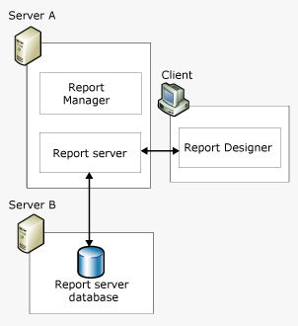
Architecture Overview
Notes:
http://nirajrules.wordpress.com/2009/12/29/sql-server-reporting-services-ssrs-architecture-overview/
- when you install SSRS it creates Report Server Databases in your SQL Server Instance. These databases are ReportServerDB and ReportServerTempDB which are used to store report configurations and other things including Caching, Session, etc. that improvise the overall performance

Slide 12
Architecture Overview (Cont’d)
Report Server
Web Services (.asmx) which allows applications to interact with Report Server database directly (http://computername/ReportServer/reportservicexxxx.asmx )
ReportingServicesService.exe Window Service functionality also includes report processing, scheduling (auto generated reports), subscriptions (mailers), etc.

Slide 13
Architecture Overview (Cont’d)
Report Manager
RM allows you to manage reports in terms configuring security access, organizing them into folders , subscribing to them, etc …
Create reports and deploy them to Report Server Database using Report Manager.

Slide 14
Architecture Overview (Cont’d)
Report Designer
Data Sources
Data Set
Parameters
Field Formats
Layout (Grouping)

Slide 15
Important Aspects of SSRS
Report Builder
Tool which is targeted at business users who want to generate custom reports on fly
Report Model
It’s a simplified view of relational database targeted at business users for ad hoc report creation
A report model is built on top of a Data Source View (.dsv) that defines a logical model based on one or more data sources
Notes:
Report Builder is a another tool which is targeted at business users who want to generate custom reports on fly
Report Model is the base for report creation with Report Builder.
RDL

Slide 16
Important Aspects of SSRS
RDL (Report Definition language)
XML file which stores query information, data source information, …
SSRS Security
Deploying Reports to Production
Integrating SSRS into your applications
Integrating Reporting Services Using SOAP
Integrating Reporting Services Using the ReportViewer Controls
Integrating Reporting Services Using URL Access
Notes:
SSRS Security: When a user accesses the Report Manager Application or ASMX Web Services he has to authenticate with a valid domain username / password. On successful login SSRS determines the role of the user (custom or built-in ones like Browser / Content Manager, etc.) and displays only those reports / folders to which user has access.

Slide 17
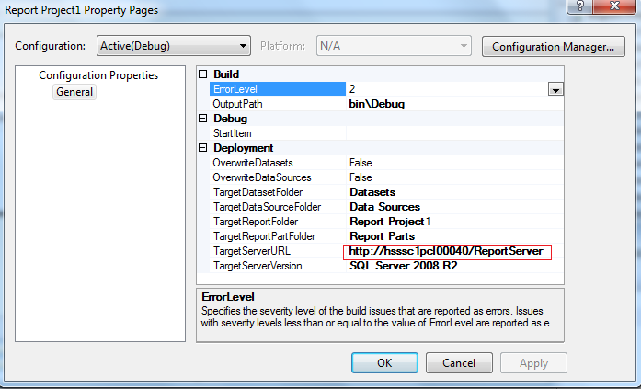
Deploying Reports to Production

Slide 18
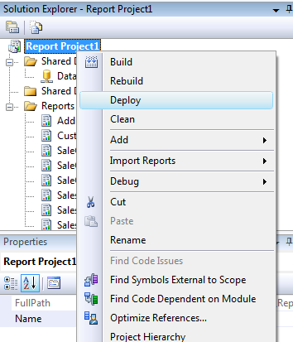
Deploying Reports to Production

Slide 19
DEMO

